Slide 1



Webinar Safe ‘n Sound
Introduction to harm reduction at your event ✊

Slide 2
Topics of the day 📣
What is harm reduction?
Quick wins with Quality Nights
Your point(s) of contact
What is Safe ‘n Sound?
Your drug policy
5 takeaways from the early adopters

Slide 3
Hi, I’m Tom! 👋
Prevention worker
Supporting organisations & local government
Addiction → drugs, gambling and gaming
CGG Vagga in Antwerp → Centre for mental healthcare
Safe ‘n Sound ☂️ VAD: Flemish centre of expertise on alcohol and other drugs
  Principle of harm reduction

Slide 4

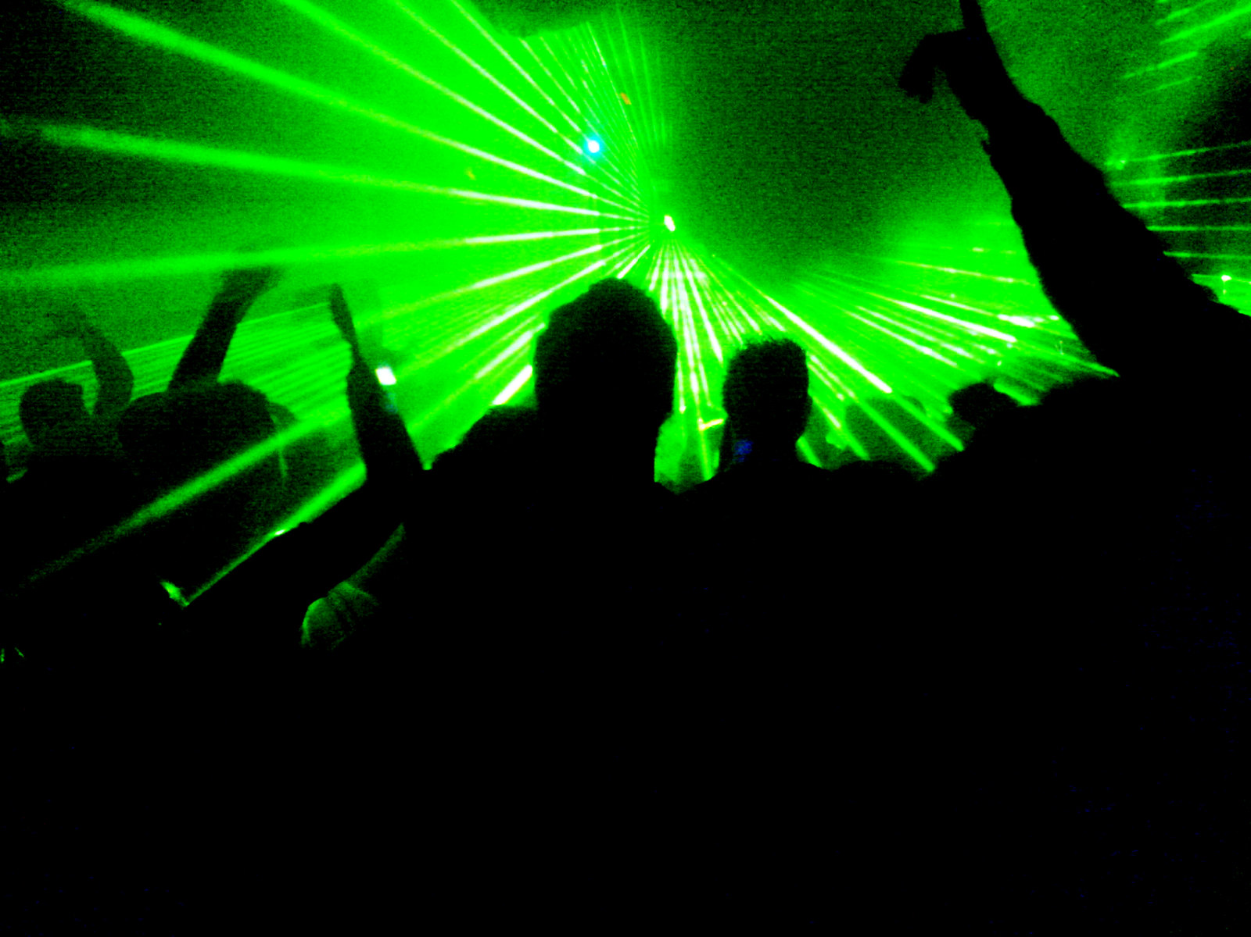
The reality of events

Slide 5
What is harm reduction?
“Harm reduction is an evidence-based approach that aims to minimise the negative health, social and legal impacts associated with drug use, drug policies and drug laws by focusing on positive change and on working with people without judgement, discrimination, or requiring that people stop using drugs as a precondition of support.”
→ But why?

Slide 6




Slide 7
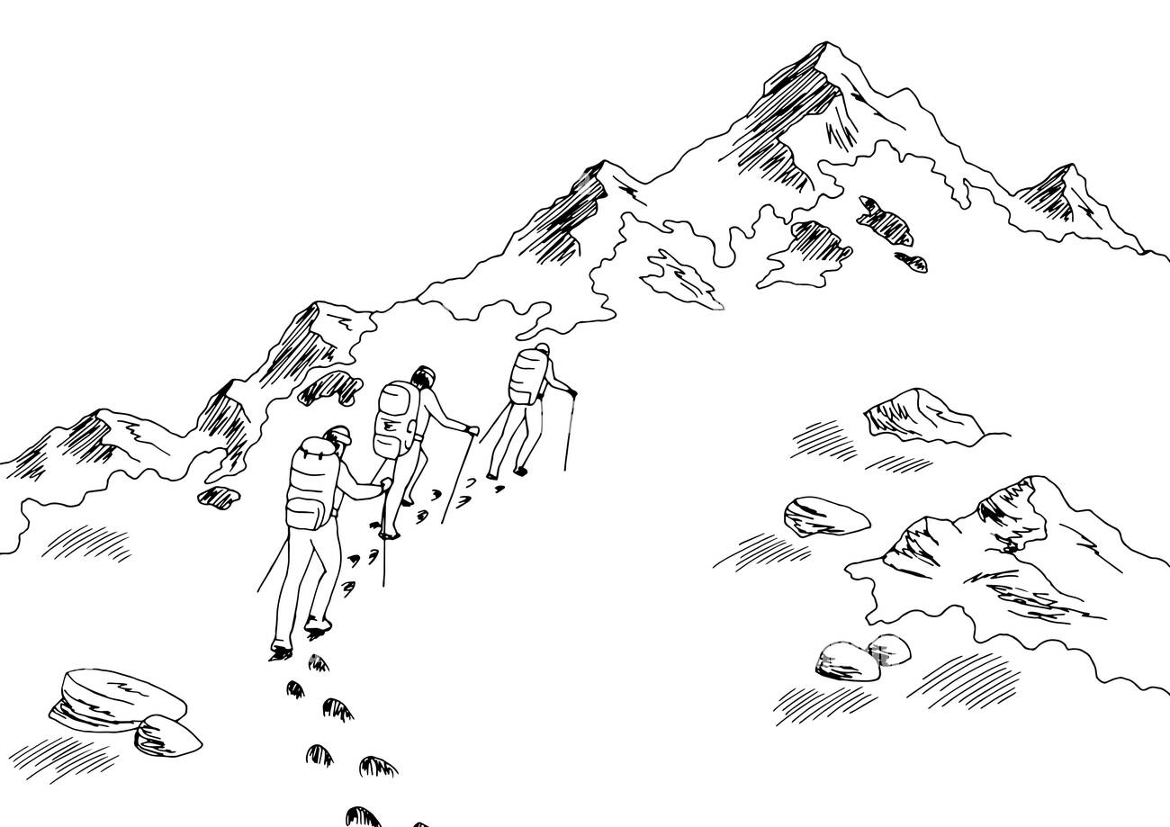

Slide 8

Quick wins with Quality Nights
= Toolkit of structural measures
Trained (bar) staff
Spreading health promotion info
Initiatives for safer transport
4-15) Availability of condoms, drinking water, chill-out space, earplugs, …
vad.be/preventie-en-hulpverlening/uitgaan/quality-nights/
https://www.qualitynights.be/fr/

Slide 9
1) Trained (bar) staff
Such as:
Serving alcohol responsibly
First aid with drug related incidents (EHBDu)
…
Either:
Face-to-face by a local prevention worker
Online training (→ vormingen.vad.be/vormingen/training-barpersoneel)

Slide 10




2) Spreading health promotion info

Slide 11
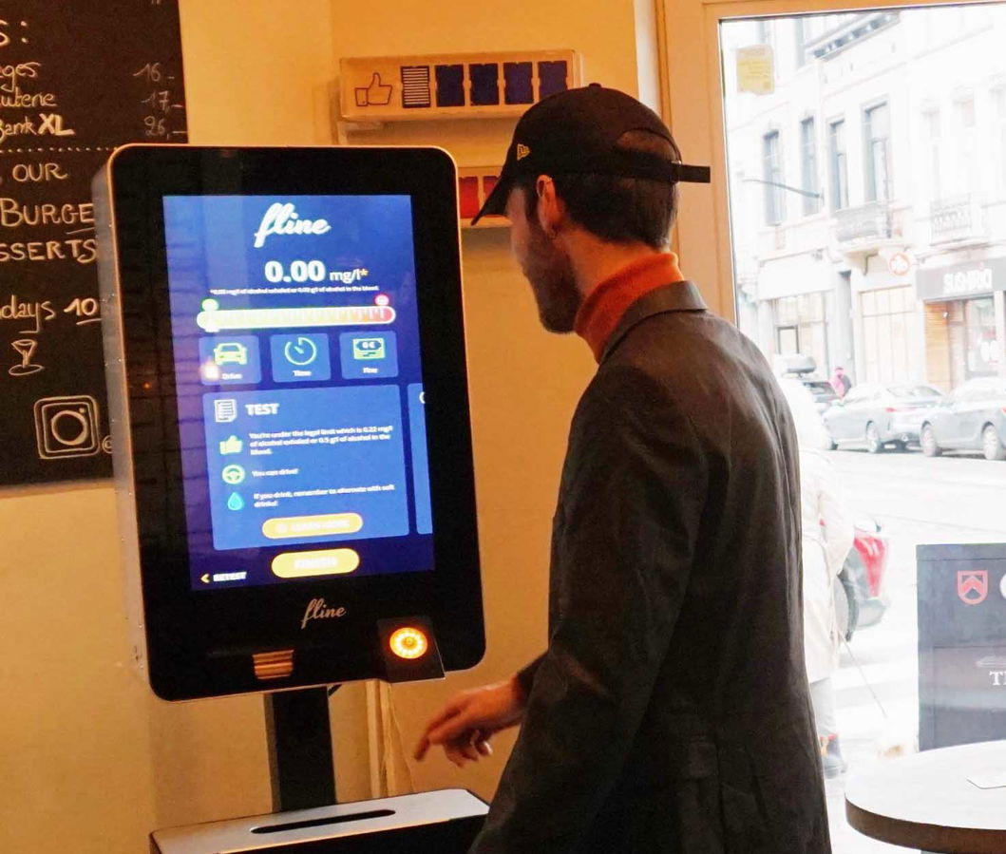
3) Initiatives for safer transport
Putting Taxi information on screens
Info on bike sharing system
Event hours vs. public transport
Alcohol testing → fline-group.com
...

Slide 12


Slide 13
Your point(s) of contact 📎
→ VAD: Flemish centre of expertise on alcohol and other drugs ☂️
→ In Wallonia & Brussels: EuroTox.org
→ Your local prevention worker 📍
→ CGG: Centre for mental healthcare
→ CAW: Centre for well-being
→ In Wallonia & Brussels: more fragmented
www.enseignement.be/index.php?page=24462#programme
→ Safe ‘n Sound 💡

Slide 14
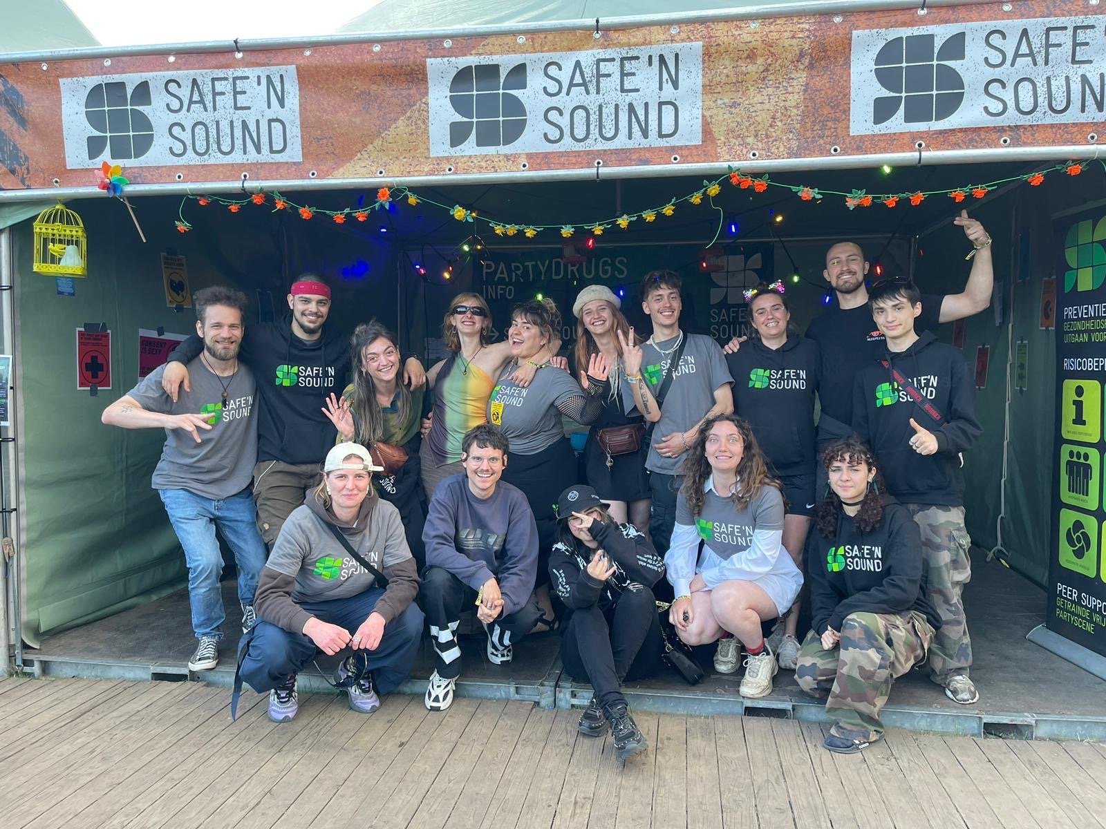
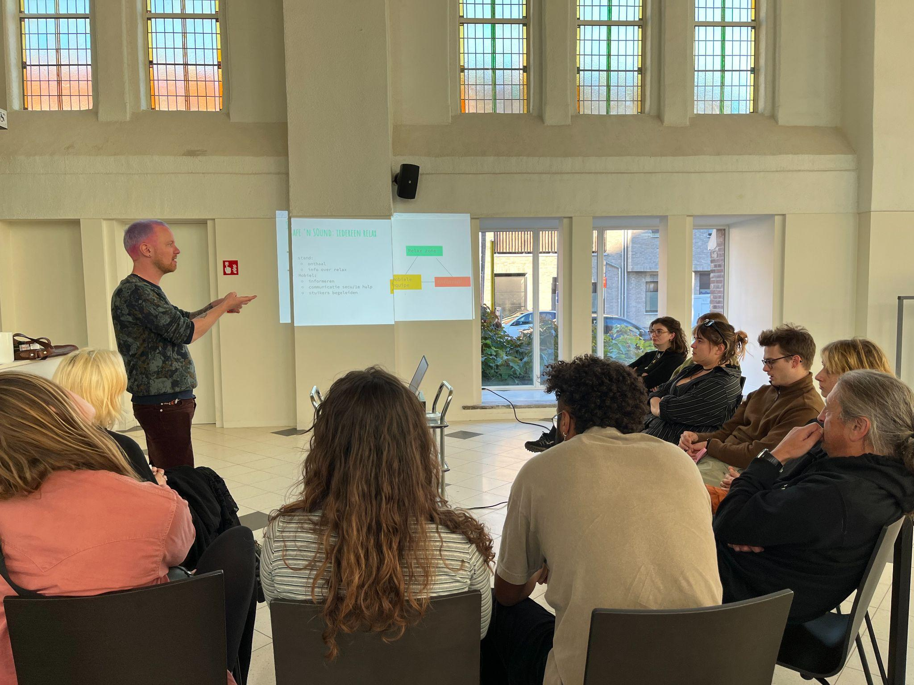
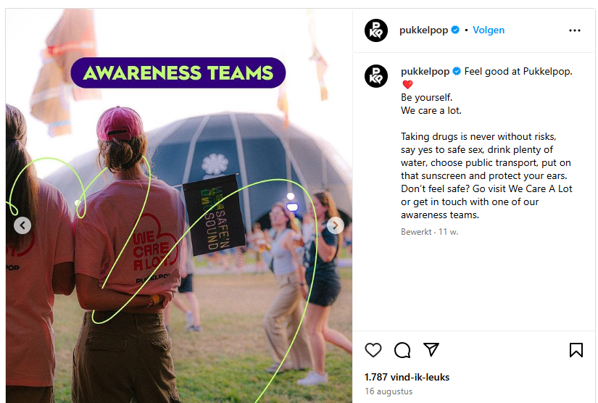
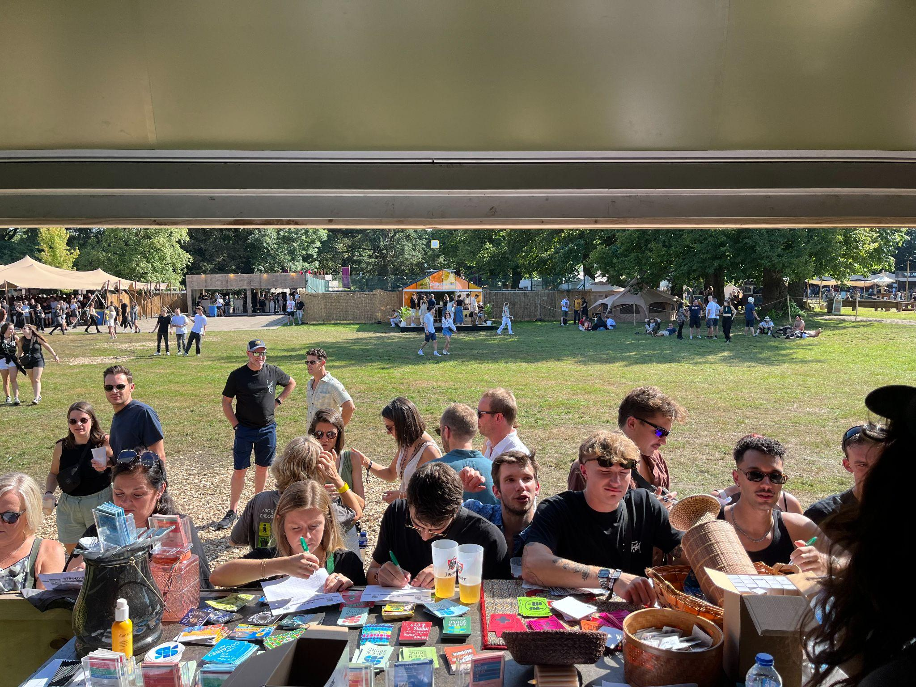
What is Safe ‘n Sound?
From theory to practice 💗
Peer-support
Nightlife setting
Trained and educated
Product information, lending an ear,
HR materials, …
Relax zone, mobile teams, …
= Informing & raising awareness
= Accessible

Slide 15



Slide 16
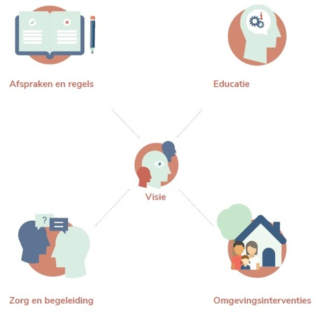
Your drug policy 📜
Integrated 🤝
Custom
Never a finished product
→ Focus group
coached by your point(s) of contact
rules and regulations
education
vision
care and support
interventions around setting

Slide 17
But … what works for you?

Slide 18
So many options! ✨
Infostand
Chill out room
Relax zone
Trained staff
Awareness / mobile teams
Integrated drug policy
Harm reduction messages
Alcohol tests
Info on public transport
Accessibility of condoms
Earplugs
Taxi/train/bus promo codes
Accessibility of drinking water
Alcohol free alternatives
Healthy food
EHBO
…

Slide 20
5 takeaways from the early adopters
Take some distance, step outside your bubble.
Be open about your plans.
Be curious, but don’t let others dictate your policy.
Dare to try, and fail (a little).
Find common ground.

Slide 21
Thank you & good luck!🫡
Tom Vandenhove
tom.vandenhove@vagga.be
vad.be --- centrageestelijkegezondheidszorg.be --- safensound.be

